Slide 1

CHOCO DE LUXE CASE STUDY
Nureni Tijani

Slide 2
Introduction
Choco de Luxe is a premium artisanal chocolate brand based in Brussels, Belgium, with a growing presence across multiple European cities. The company offers a diverse portfolio of chocolate products through retail stores, online platforms, and supermarkets.
Despite a strong market presence and product quality, Choco de Luxe has faced challenges in understanding sales performance across different locations, channels, and product lines. Business leaders have identified a critical need for data-driven insights to guide decision-making and improve efficiency.
This document provides a detailed insight into Choco De Luxes' Sales Performance, Channel Effectiveness, Sales Team Performance, Product and Pricing Strategy, and Organic Product Demand.

Slide 3
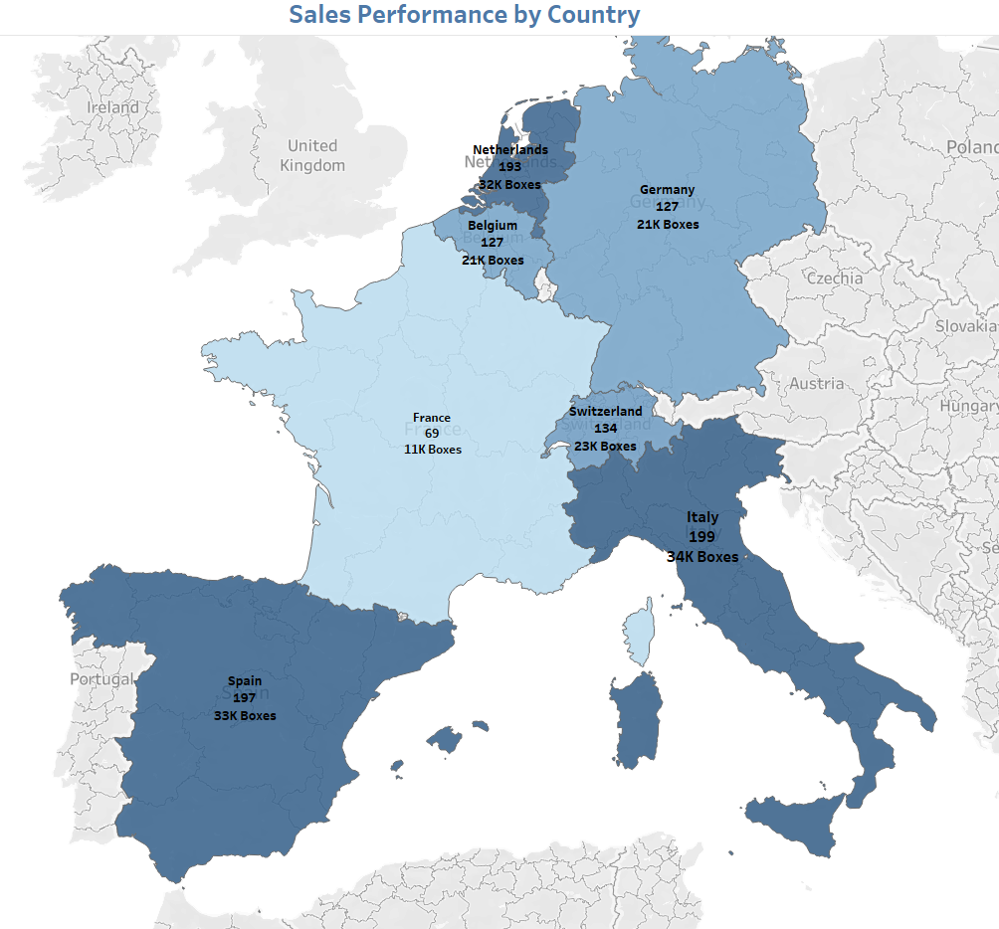
Location Sales Performance
Analysis
Belgium and Germany are the highest-performing countries, accounting for the bulk of total revenue and order volume.
Countries such as Portugal and Spain report low sales and reduced delivery efficiency.
Germany follows closely, demonstrating strong adoption and product penetration, particularly in urban markets.
Italy and the Netherlands show moderate performance but untapped potential given their market size.
Recommendations
Reinforce promotional campaigns in Belgium and Germany to maintain dominance and test new products. Conduct market assessments in Spain and Portugal to identify demand barriers, such as cultural preferences or pricing sensitivity. Improve delivery coordination in low-performance countries to reduce failed orders. Use Belgium's operational model as a template for regional expansion.

Slide 4
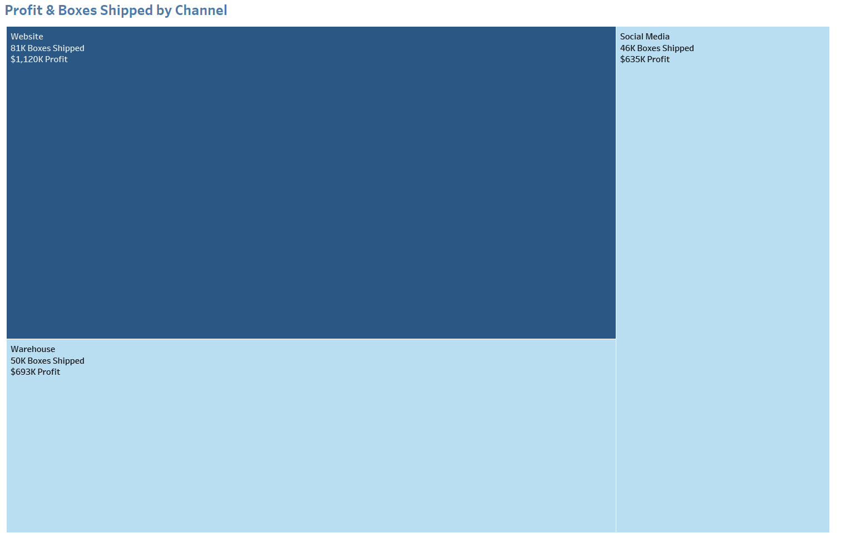
Channel Effectiveness
Analysis
The Warehouse channel shows the highest volume of boxes shipped but delivers relatively lower profit margins. This suggests a model optimized for bulk distribution but potentially affected by storage, handling, or fulfillment costs.
The Website (Online channel), although responsible for fewer shipments, generates the highest profit per box. This is likely due to premium pricing, direct-to-consumer efficiency, and fewer intermediaries.
Social Media sales, while still emerging in volume, show promising margins and growth potential — particularly for younger demographics or during promotions and product launches. However, its current impact is limited in total sales.
Recommendations
Optimize warehouse operations by renegotiating supplier rates, cutting fulfillment costs, and offering bulk discounts to improve profitability.
Enhance website performance through SEO, personalized email campaigns, and conversion-focused landing pages, promoting premium and organic products.
Utilize social media for growth with influencer campaigns, flash sales, and exclusive online launches; analyze ROI to refine strategies.
Monitor profit-per-box and return rates across channels to adjust pricing, delivery, and promotions effectively.

Slide 5
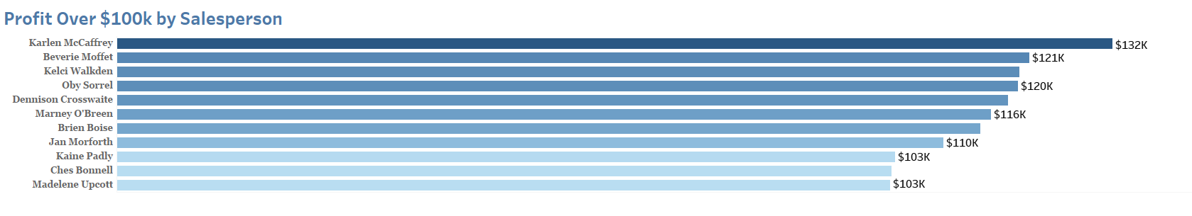
Salesperson Productivity
Analysis
Only a limited number of salespeople surpass the €100,000 profit threshold, indicating performance concentration within the team.
These top performers tend to operate in high-demand regions and favor high-margin product lines, such as organic dark chocolate and limited editions.
Several salespeople fall far below the target, and in some cases, sales volume is adequate, but profit remains low, implying issues with discounting or customer targeting.
Recommendations
Recognize top performers with commissions and recognition programs.
Analyze their behaviors to replicate success across the team.
Develop coaching for mid- and low-performers, and realign sales territories for equitable profit potential.
Set dynamic goals based on the opportunity index, including channel strength and territory size.

Slide 6
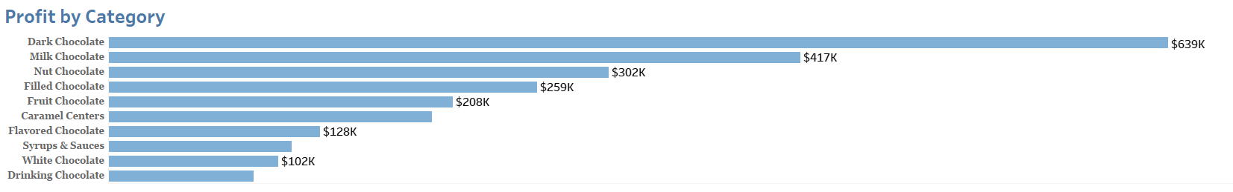
Product-Level Productivity
Analysis
Dark Chocolate dominates in terms of profit contribution, benefiting from high pricing and consistent demand across regions.
Caramel Stuffed Bars also perform well, indicating that indulgent product lines resonate with the customer base.
Milk Chocolate and flavored variants like mint or chili-based SKUs sell in volume but show lower margins, possibly due to discount dependency or higher production costs.
The profit distribution suggests that while product variety exists, only a few core categories drive profitability.
Recommendations
Focus on premium lines (e.g., Dark Chocolate and Caramel bars) as profit drivers.
Analyze costs and pricing for lower-margin categories and consider bundling or repositioning them for growth (e.g., value packs).
Regularly review product margins and phase out underperforming products.
Use category performance to inform future R&D investments.

Slide 7
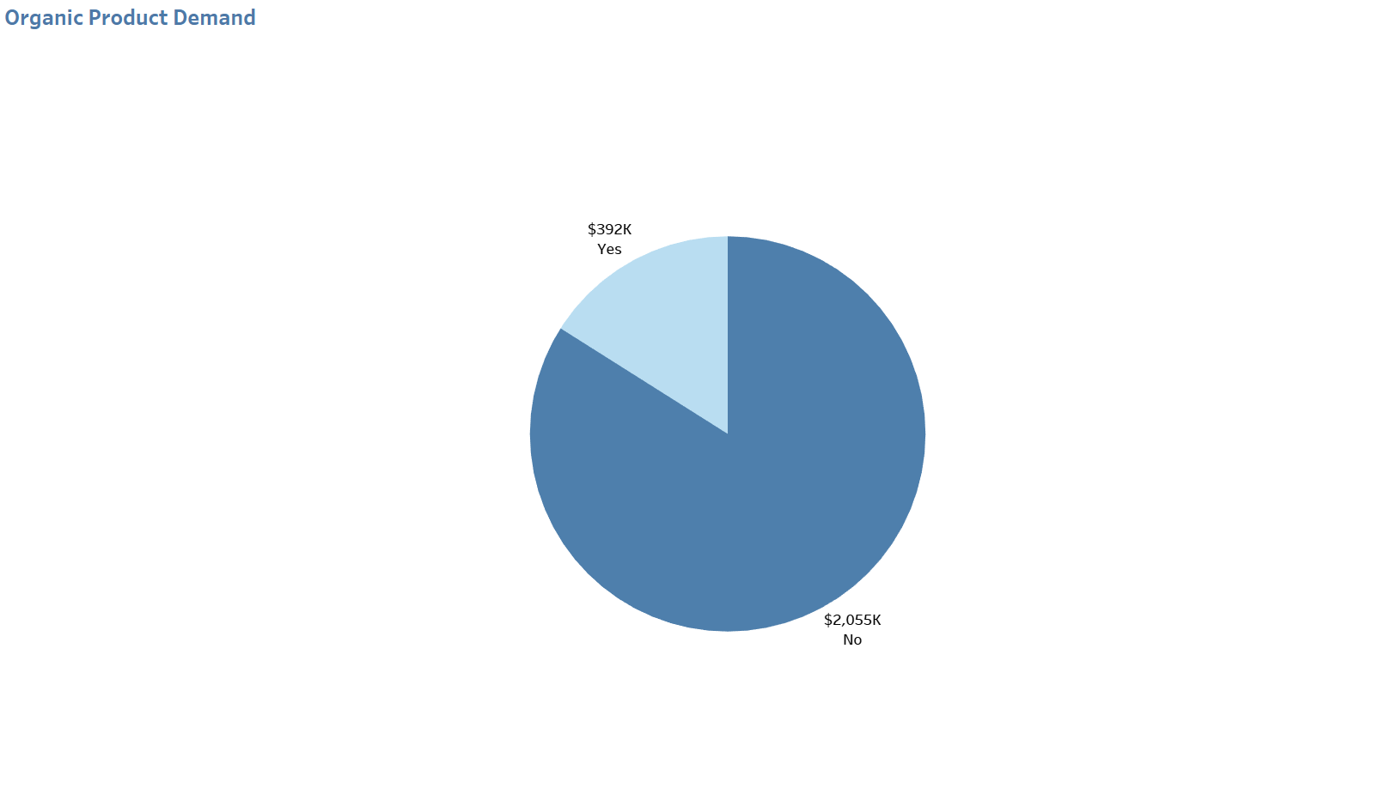
Organic Product Demand
Analysis
Organic products make up a small but profitable portion of the overall portfolio. They are most successful in online and retail channels where health-conscious buyers are more concentrated.
In wholesale and supermarket channels, demand for organic variants lags behind, suggesting a disconnect with the end-consumer in these distribution methods.
Organic products show higher unit profit despite lower volume, indicating pricing power and perceived value among certain demographics.
Recommendations
Expand organic product availability online where premium and ethical branding resonates most.
Launch educational or promotional campaigns in supermarkets and wholesale spaces to build awareness and justify pricing.
Use customer segmentation data to identify markets and age groups most receptive to organic products and adapt packaging and messaging accordingly.

Slide 8
